Slide 1


Improved Safety ALGORITHM

Slide 2
ABSTRACT
This report presents the review of two innovative techniques for safe state detection in a system.
The first approach is based on the maximum resource requirements of processes and the minimum resources availability.
The second approach is the review of a Modified Safety Algorithm based on dynamic programming. In this technique, the burst time of the processes is also considered to find the optimal safe sequence of processes that leads to a minimum average waiting time.

Slide 3
PROBLEM STATEMENT
The Classic Bankers safety detection algorithm (CBA) achieves a high runtime complexity of O(n²m) where n is the number of processes and m is number of resource instances. This leads to lot of time consumption when number of processes are large.
A need for improvisation in the CBA has been felt since a long time. Several researches have been conducted along this direction and have suggested a multitude of variations. In our research review we have mainly focused upon the improved safety algorithm stemming from one such variation.
Another limitation of the CBA is that it returns one of the many possible safe sequences. However, the optimal safe sequence is the one that leads to minimum starvation of the processes i.e. has minimum average waiting time. Hence, we have made an attempt to finding the optimal safe sequence through a Dynamic Programming based approach

Slide 4
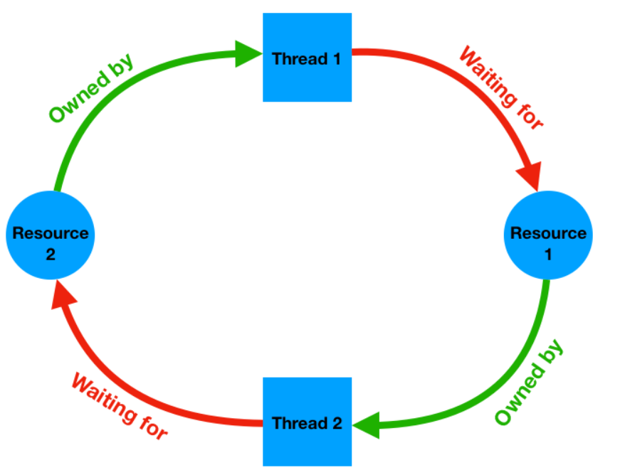
INTRODUCTION
Deadlock is a phenomenon due to the blocking of system resources among competing processes. It describes a state of a collection of some parts trapped into an endless loop waiting for service which is occupied by other parts, vice versa.
Safe sequence is an enumeration P₁,P₂,... , ,P_{n} of all the processes in the system, such that for each i=1,2, ... ,n, the resources that P_{i} may request are a subset of the union of resources that are currently available, and resources currently held by P₁P₂….P_{i-1}.
Theorem : A system of processes and resources is in a safe state if and only if there exists a safe sequence{ P₁,P₂,...P_{n}}. If there is no safe sequence, the system is in an unsafe state.

Slide 5
LITERATURE REVIEW
The fundamental deadlock avoidance approach is the well-known Banker’s Algorithm in the operating system realm. Dijkstra first introduced BA for single multiple-instance resource systems, and later Habermann improved it for multiple-instance multiple-resource systems. In BA, each process declares the maximum possible number of instances for each resource it may need.
The run-time complexity of the Habermann’s BA in software is O(mn²) , where and m and n are the numbers of resources and processes, respectively. The efficiency of the algorithm was later improved to O(mn) by Holt.
Even though BA was proposed a few decades ago, minor variations to BA are still being proposed for critical systems that can greatly benefit from the algorithm. For instance, in 2002, J. Ezpeleta at al. proposed a banker’s solution for deadlock avoidance in flexible manufacturing systems.

Slide 6
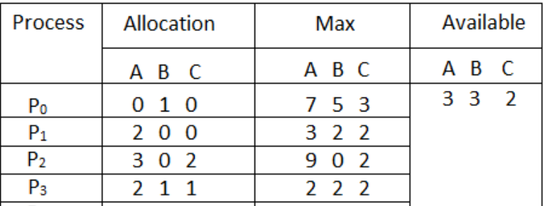
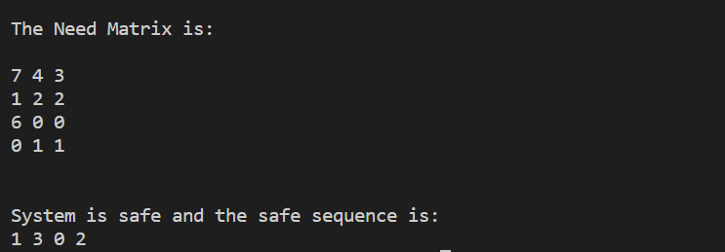
CLASSSIC BANKERS ALGORITHM
Classic Safety Algorithm:
1. define vector: Finish[k] = false ( ∀ k ≤ n)
2. find an i such that (Finish[i] == false && Need[i] ≤ Work) if no such i, then go to STEP 4
3. update: Work = Work + Allocation[i], Finish[i] = true go to STEP 2
4. if (Finish[i] == true) ∀ i, then the system is in a safe state otherwise, the system is in an unsafe state.
Link to Program Code:
https://docs.google.com/document/d/1udQhNA6eUfaCGdGe7Apx59nLApbj5H7zh3sCvwLe_-o/edit?usp=sharing

Slide 7
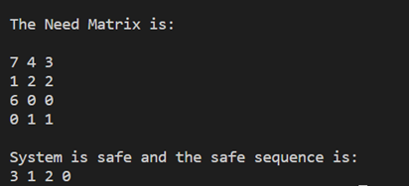
PROPOSED METHODOLOGY
Our proposed algorithm is based on a sorting method and the linked list data structure. In this algorithm the processes are sorted in increasing order based on the maximum number of resources of any type needed by a process.
Therefore, when we check the processes in safety algorithm the processes with lowest resource requirement comes first. We don’t need to check the process sequence more than once. Here we use the linked list as data structure to store the additional resource requirement of each process to complete its execution.
By using sorting method, our algorithm reduces the complexity of the safety detection part.
Link to Program Code: https://docs.google.com/document/d/1kf1ERlHpFKQK__-t3SfwvPyslOhorYZwn-Ja79- cjAk/edit?usp=sharing

Slide 8
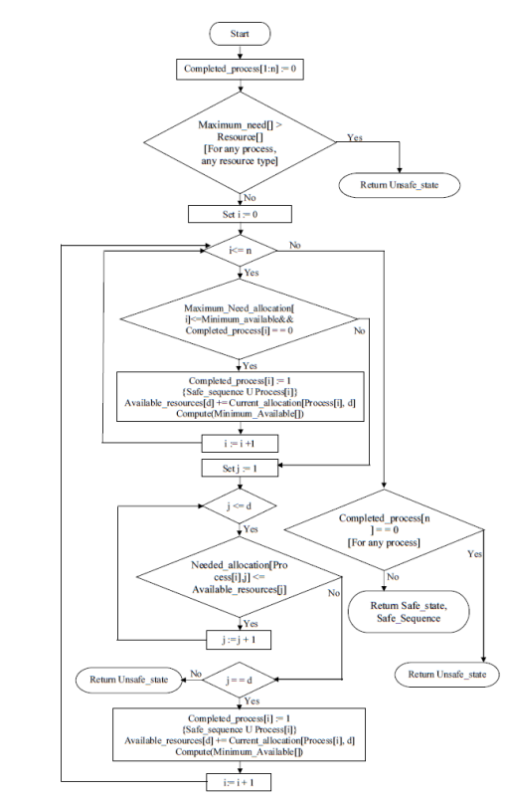
ALGORITHM
1. for (1≤ i ≤n){ Completed process[i]:= 0 }
2. for (1≤i≤n,1≤ j ≤d) {
if (Maximum need[i,j]>Resource[j] )
{ return unsafe state} }
3. Sort(Process[n] ,Maximum Needed
allocation[n])
4. for (1≤ i ≤ n) {
if ( Maximum Needed allocation[i]
≤Minimum Available and
Completed process[Process[i]] == 0){
Completed process[Process[i]]:= 1
Safe sequence:= { Safe sequence U Process[i]}
Available resources[d]:=Available resources[d]
+ Current allocation[Process[i],d]
Compute(Minimum Available) }
else { for (1≤j≤d)
If (Needed allocation[Process[i],j]≤ Available resources[j])
{ Continue ;}
else { Break ;}
if (j == d) {
Completed process[Process[i]]:= 1
Safe sequence := { Safe sequence U Process[i] }
Available resources[d]:=Available resources[d] +
Current allocation[Process[i],d]
Compute(Minimum Available) }
else {return unsafe state ;} } }
5. for (1≤ i ≤ n ) {
if (Completed process[i]== 0)
{return unsafe state } }
6. return safe state and Safe sequence.

Slide 9
ANIMATION
Sort on the basis of Max_Needed_Allocation
Available = [6 12 4 9 8]
Available = [8 12 4 15 13]
Available += Allocation(P3)
Available = [6 8 4 4 8]
Available += Allocation(P2)
Available = [4 5 2 4 7].
Available += Allocation(P1)
Safe Sequence = P3 P1 P2 P4 P0 P5 P6 P7
Continuing in a similar manner for all processes……
Max_Needed_Allocation(P3) = 2
Min Available = 2
Max_Needed_Allocation <= Min Available
=> P3 can be executed
Max_Needed_Allocation(P2) = 3
Min Available = 4
Max_Needed_Alloction <= Min Available
=> P2 can be executed
Max_Needed_Allocation(P1) = 3
Min Available = 4
Max_Needed_Alloction <= Min Available
=> P1 can be executed

Slide 10
DEADLOCK AVOIDANCE WITH BURST TIME : Dynamic Programming
The dynamic programming-based approach generates all possible sequences at each step and purges out those sequences that do not lead to the optimal sequence. (identified with minimum average waiting time)
We make use of two dominance constraints to apply principle of optimality in the solution anon optimal safe and purge out safe sequences that are not optimal.
If the process needs are greater than the available resources in the system at any state, then that state will be purged out and not be further explored.
If any level i contains any two states having elements { R_{j}, W_{j} } and { R_{k}, W_{k} }, where Rj = (R₁, R_{2,} … R_{m}) at one state j and R_{k} = (R₁, R₂, … R_{m}) at another state k, represent the available resources at that state. Wj and Wk represent the total waiting time till state j and k respectively. If (R_{k} ≥ R_{j} && W_{j} > W_{k}) then set {Rj, Wj} will be purged. R_{k} ≥ R_{j} will be true only if every element of R_{k} is greater than or equal to that of Rj.

Slide 11
DEFINITIONS USED IN THE ALGORITHM
Let S^{i} [p₀, p₁, …, p_{n-1}] represent the state at level i where subscript [p₀, p₁, …, p_{n-1}] represents the permutation of p₀, p₁, …, p_{n-1} by taking any number of elements from [p₀, p₁, …, p_{n-1}].
So, S^{i} [p₀, p₁, …, p_{n-1}] = {(R^{i} [p₀, p₁, …, p_{n-1}]), W^{i} [p₀, p₁, …, p_{n-1}] } represent state in the state space, is a set of two elements.
(R^{i}[p₀, p₁, …, p_{n-1}]) represents the available resources in the system at level i and state [p₀, p₁, …, p_{n-1}]. W^{i} [p₀, p₁, …, p_{n-1}] represent the total waiting time at state [p₀, p₁, …, p_{n-1}] and level i.
Allocation(S^{i} [p₀, p₁, …, p_{n-1}]) : It is the total number of allocated resources to the process P_{k}, where k (k can be the any number from 0, 1, …, n-₁) is the last position in the sequence of [p₀, p₁, …, p_{n-1}].
WT(S^{i} [p₀, p₁, …, p_{n-1}]) : if the Pk is the last process in the explored sequence then WT (S^{i} [p₀, p₁, …, p_{n-1}]) represents the total waiting time of the processes in the explored sequence except the last process P_{k}.

Slide 12
ALGORITHM
Step 1: Define the first state S⁰, S⁰ = {(R₀), W₀ }, where R₀ = (R₁, R₂, … R_{m}) are the initially available resource types in the system and W₀ is the total waiting time at level 0, so initially it will be 0.
Step 2: Generate S^{i} [p₀, p₁, …, p_{n-1}] from S^{i-1}[p₀, p₁, …, p_{n-1}]
Trying out all possible values for P_{i} (i = 0, 1, … n-1) (except those P_{i} that already explored, along the path from the root, initially NILL processes are explored) and
i) If the need of the process is greater than R^{i-1} [p₀, p₁, …, p_{n-1}] then this state will be purged by the dominance Rule 1.
ii) If the new generating state does not comes under dominance rule no 1, then do the following
a. S^{i}[p₀, p₁, …, p_{n-1}] = {(R^{i-1}[p₀, p₁, …, p_{n-1}] + Allocation (S¹ [p₀, p₁, …, p_{n-1}]), WT (S¹ [p₀, p₁, …, p_{n-1}])}
iii) If the states in the same level satisfy the dominance Rule 2 then one state will be purged as mentioned in that rule.
Step 3: Repeat Step 2, till the state space reached at level n.
Step 4: Finally the branch that goes from level 0 to level n-1 and having the minimum waiting time will represent the optimal safe sequence of the processes.

Slide 13
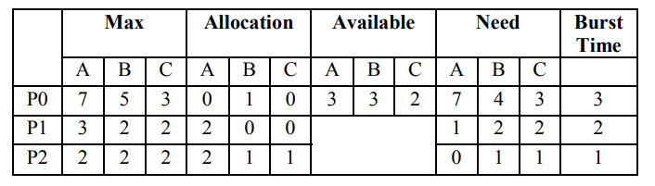
ANIMATION
{3,3,2}, 0
P0
Optimal Safe Sequence: P2 P1 P0
P1
P2
{7,4,3} > {3,3,2}
X
{1,2,2} <= {3,3,2}
{0,0,1} <= {3,3,2}
{5,3,2},0
{5,4,3}, 0
{5,3,2}, 0
P1
Work = {2,0,0} + {3,3,2}
Work = {2,1,1} + {3,3,2}
P0
P2
{5,4,3}, 0
P0
X
X
X
{7,4,3} > {5,4,3}
{1,2,2} <= {5,4,3}
{7,4,3} > {5,3,2}
{0,1,1} <= {5,3,2}
{7,4,3}, 1
{7,4,3},2
Work = {2,0,0} + {5,4,3}
Work = {2,1,1} + {5,3,2}
{7,4,3}, 1
{7,4,3}, 2
P0
{7,4,3} <= {7,4,3}
{7,4,3}, 4
Work = {0,1,0} + {7,4,3}
✓
{7,5,3}, 4

Slide 14
SOFTWARE AND HARDWARE REQUIRMENT
Integrated development environment (IDE) preferably​ VS CODE.
Process and their resource requirements, allocation state and available state.
Process scheduler for bringing in processes into ready queue and then transferring them from ready queue to the running state.

Slide 15
RESULTS
The algorithm proposed by us found to be is n times faster than the original banker’s algorithm.
In our algorithm, we have eliminated the use of complex and large dimensional permutation matrices. Our algorithm uses dynamic memory allocation for data structures that reduces the memory requirement.
In the best case condition, we found out that the algorithm needs only n comparisons to detect the safe state of any system, whereas the original banker’s algorithm would need O(n²d)

Slide 16
FUTURE SCOPE
In the future, we plan to apply the proposed new algorithm for the purpose of deadlock avoidance and conduct a more comprehensive analysis to validate our method with some undesired processes.
We suggest to use linked list data structure for improving on the O(nd²) space complexity. Because linked list is dynamic data structure, it is very efficient for memory utilization, access time is very fast and there is no need for pre-allocation of memory.
The present and future of this area is bright, and full of opportunities and great challenges as it possesses high demands. In future it can be used for the auto added process and killing the undesired process

Slide 17
CONCLUSION
In this study we have discussed on improving the problems of CBA which are high cost in terms of not only the time complexity and space complexity of the algorithm, but also in its limits the concurrency of the system.
The proposed algorithm uses dynamic memory allocation for data structures. We considerably reduce the time complexity of the safety check from O(n²d) to best case of O(n) and average case of O(nlogn +nm)
The experiment indicates that such an improved algorithm can increase the efficiency of deadlock detection. However, this algorithm turns out to be restrictive for some arrangement of processes. If that happens, it may return an apparent deadlock. Therefore, more comprehensive analysis is required to validate our method with such undesired processes.

Slide 18
REFERENCES
An Improved Safety Detection Algorithm Towards Deadlock Avoidance by Momotaz Begum
Deadlock avoidance algorithm with a modified bankers algorithm by Ferenc belik.
Dynamic and improved Implementation of bankers algorithm​ by Ms. Kshipra Dixit.
An Improved Parallel Banker's Algorithm Based on Petri Net by Xiaohui Ma,Junya Yan.
Modified Banker's algorithm with dynamically release resources by Dan Song.

Slide 19

Thank You

